Slide 1
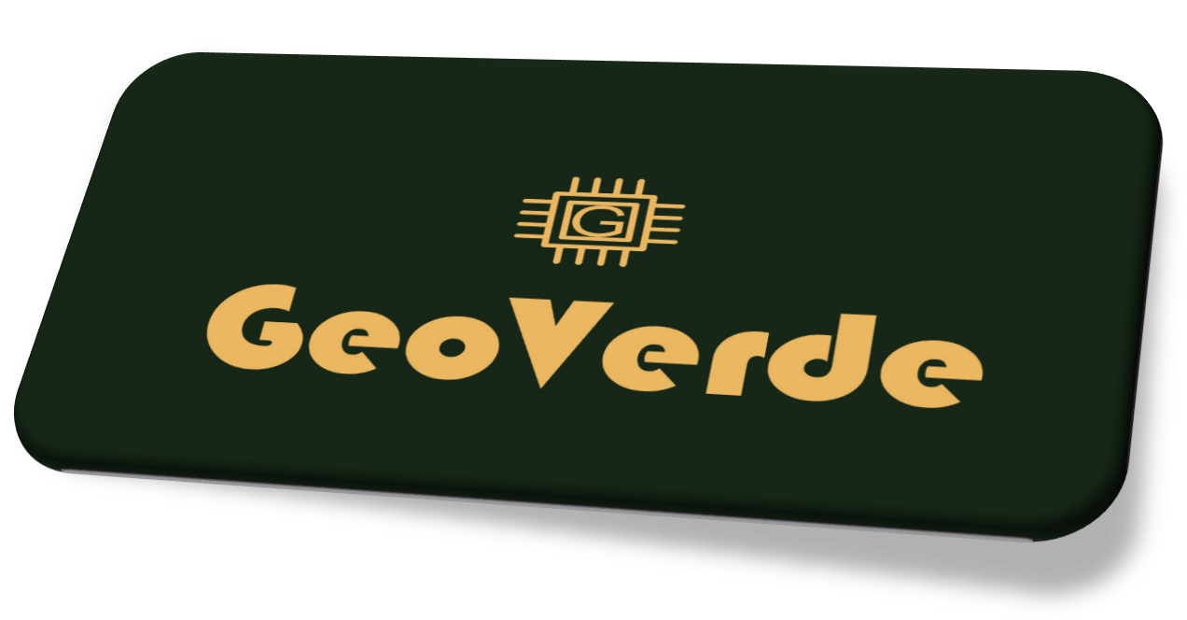
NFT Project

Slide 2

Project Planning and Setup
- Instructions:
- Create a shared folder in Google Drive or GitHub to keep your project files together.
- Use Trello or a similar tool to organize tasks and see who is working on what.
- Pick a chat app like WhatsApp to stay connected with your team.

Slide 3

Collecting GIS (Geographic Information System) Data using ArcGIS Tools
- Instructions:
- Sign up for ArcGIS Online and explore its capabilities.
- Learn how to use ArcGIS Notebooks to collect and analyze geographic data.
- Create and execute Python scripts in ArcGIS Notebooks to fetch and visualize satellite data.
- Download and store the collected images for further processing.

Slide 4

Algorithm Development for NFT Conversion using Visual Studio Code
- Instructions:
- Set up Visual Studio Code for coding and ArcGIS Notebooks for scripting.
- Research and design the NFT conversion algorithm.
- Write Python code for the algorithm in ArcGIS Notebooks and Visual Studio Code.
- Use the Pillow library to manipulate images and add metadata to create NFTs.

Slide 5
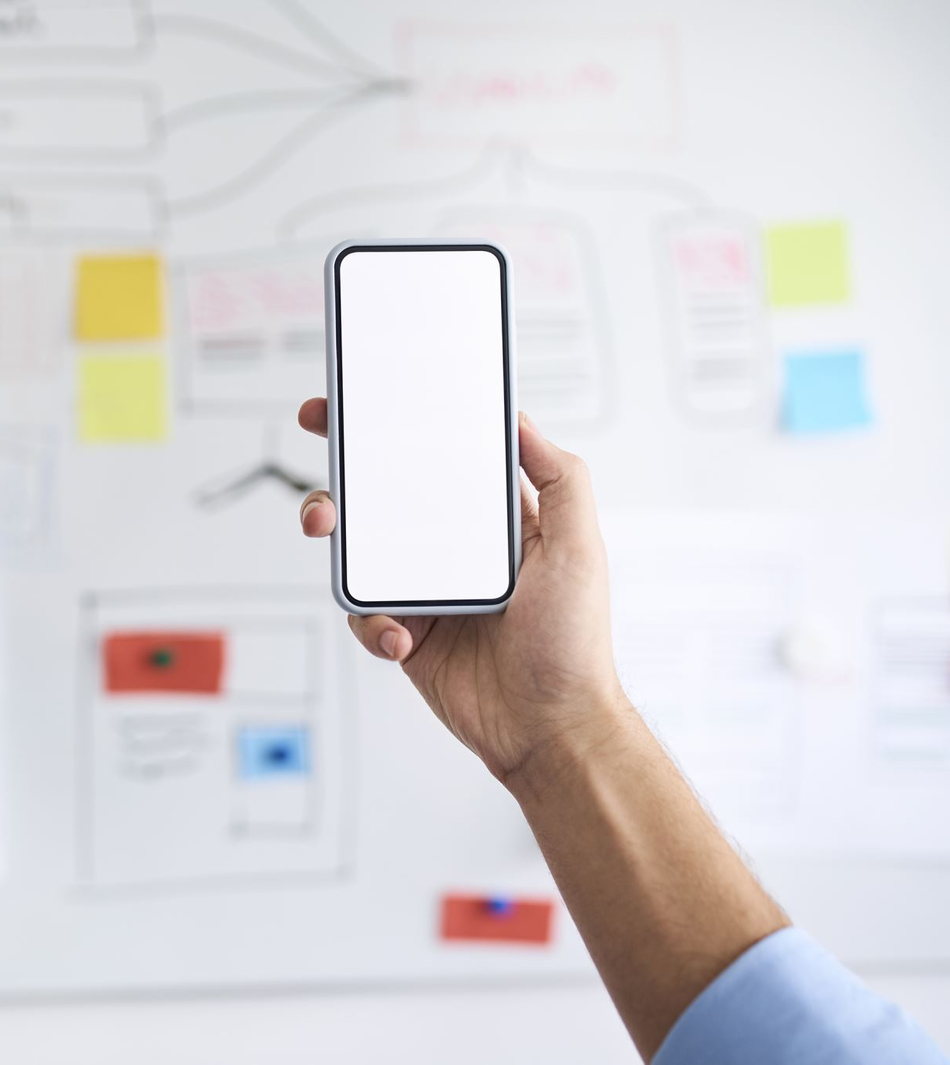
Algorithm Testing and Optimization in Visual Studio Code
- Instructions:
- Test the algorithm using sample images and data in ArcGIS Notebooks.
- Debug any issues in the algorithm using the debugging tools in both ArcGIS Notebooks and Visual Studio Code.
- Optimize the code for performance by identifying and refining bottlenecks.
- Collaborate with your team to find areas for improvement and optimization.

Slide 6
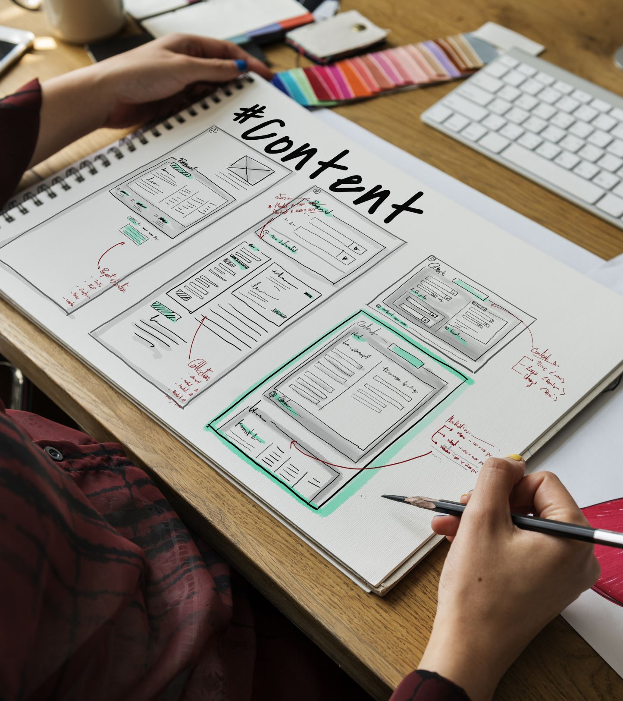
User Interface Design and Development using Simple App Tools
- Instructions:
- Start with a simple app creation tool like Thunkable or Appy Pie.
- Draw a sketch of how your app should look, with buttons for uploading images and creating NFTs.
- Follow the tool's instructions to drag and drop elements to build your app's interface.
- Experiment with adding buttons, text, and images to your app layout.

Slide 7

App Integration and Full Process Testing
- Instructions:
- Integrate the NFT conversion algorithm from ArcGIS Notebooks into the app tool.
- Configure the app to send images to the NFT algorithm and receive NFTs.
- Thoroughly test the app's functionality by simulating user interactions.
- Debug and refine the integration to ensure seamless communication.

Slide 8

App Refinement and User Testing
- Instructions:
- Imagine your app as a bicycle – ride it to find any bumps or wobbles (bugs).
- Share your app with friends or classmates and gather their feedback.
- Use their suggestions to fix anything that seems confusing or broken.

Slide 9
Documentation, Deployment, and Finalization
- Instructions:
- Write an easy guide for your project, explaining how it works step by step.
- Use your app tool's instructions to create an app package for Android or iOS.
- Share your app with friends or upload it to a testing platform to check if it works for others.
- Double-check everything, make sure it is all working well, and your project is good to go!

